Slide 1

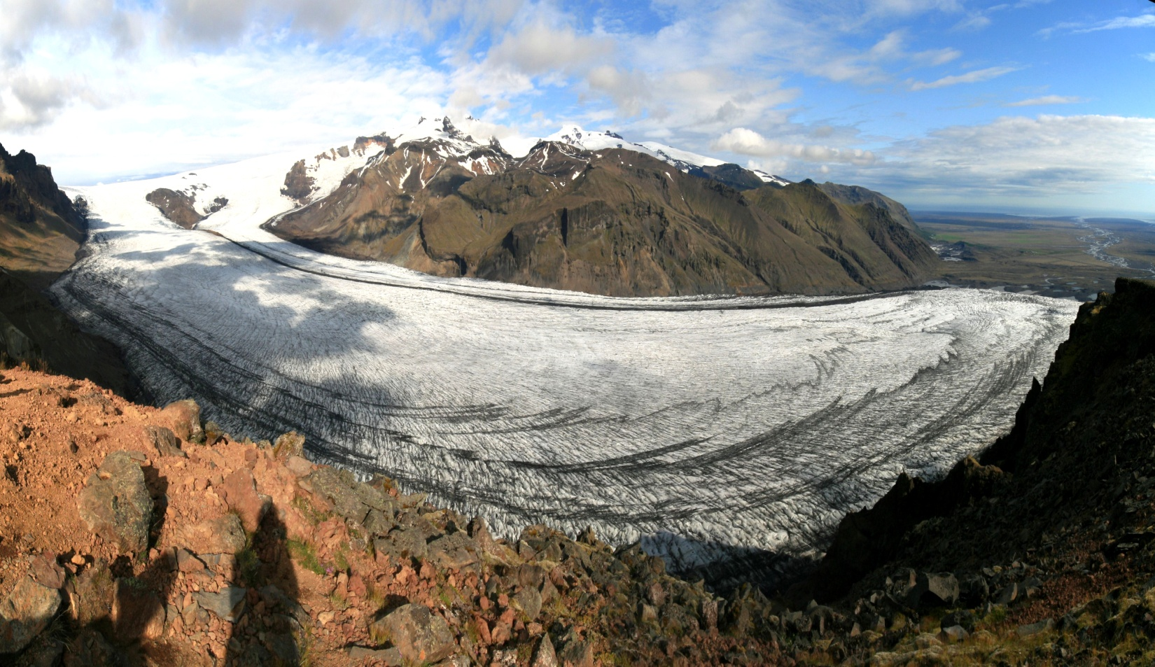
FACULTY OF SCIENCE
SCHOOL OF GEOGRAPHY, EARTH AND ATMOPSHERIC SCIENCES
GEOG30023/90026 Global climate change in context

Slide 2
Aims of the subject
To examine the nature and causes of past changes in Earth’s climate during the Quaternary Period (the last 2.6 million years), with a particular emphasis on the last 130,000 years.
To place recent (anthropogenic) climate change and global-warming projections into a longer-term perspective, allowing students to understand why human interference in the climate system is a legitimate cause for concern.
To investigate how Earth materials (ice, rocks, sediments, landforms, biological materials) record past climate changes, the techniques used to extract this information, and the principles that govern how this information is interpreted.
The main component of the subject is a 12-day field trip to the South Island, NZ.

Slide 3
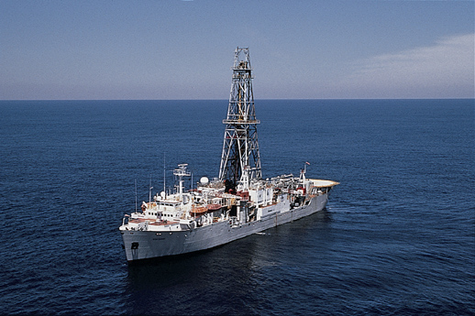
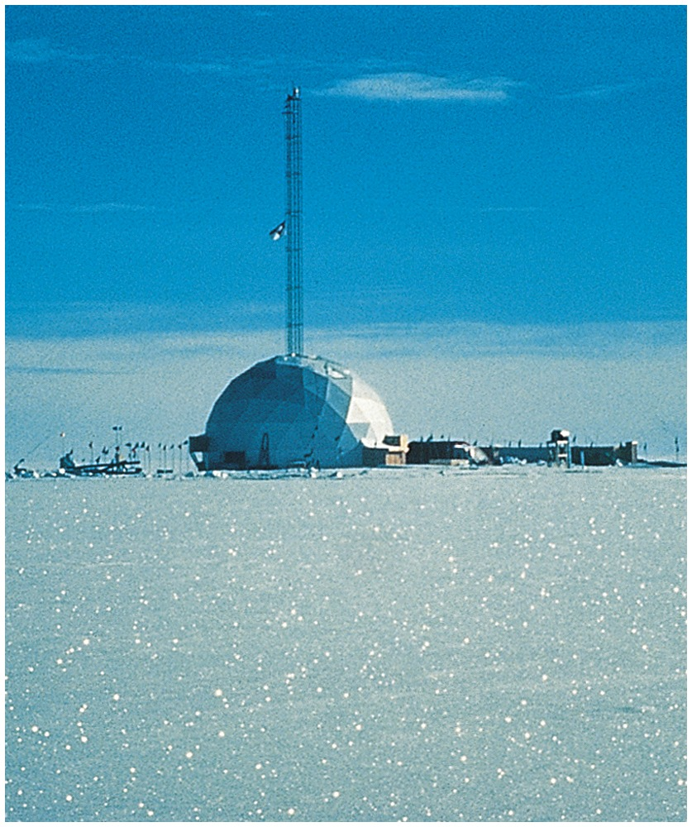
Palaeoclimatology
From Ruddiman (2008) Earth’s
Climate: past and future

Slide 4
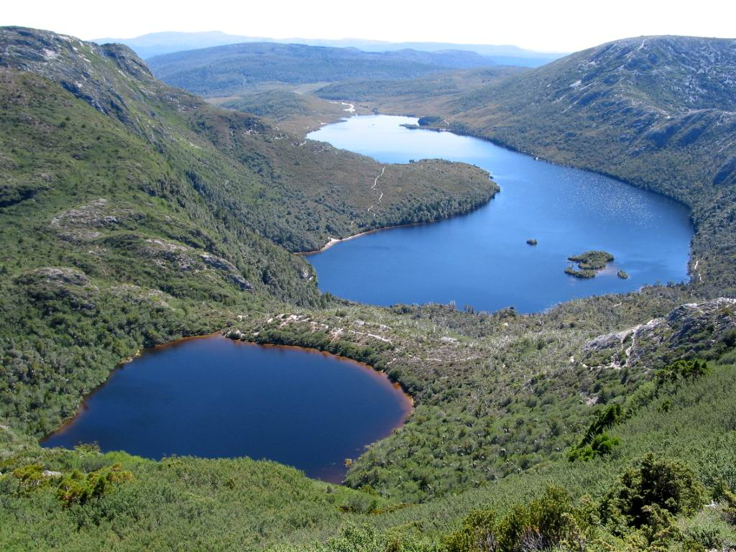
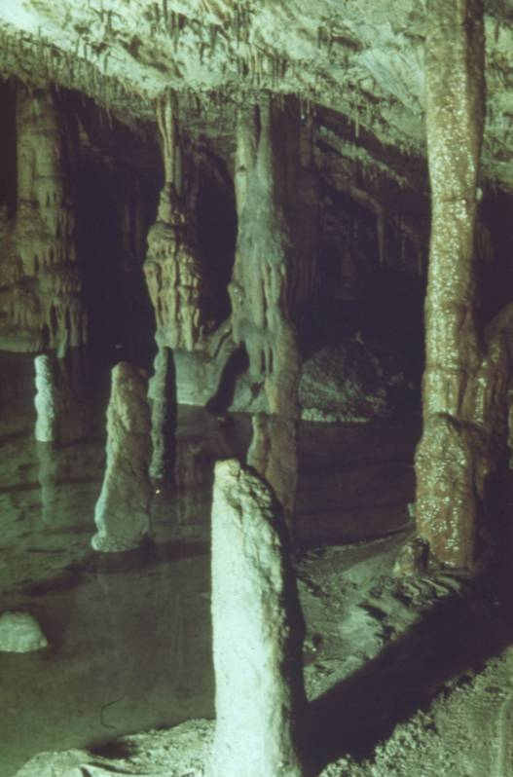
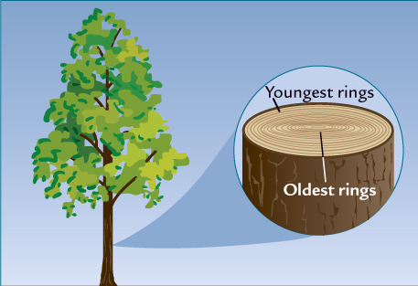
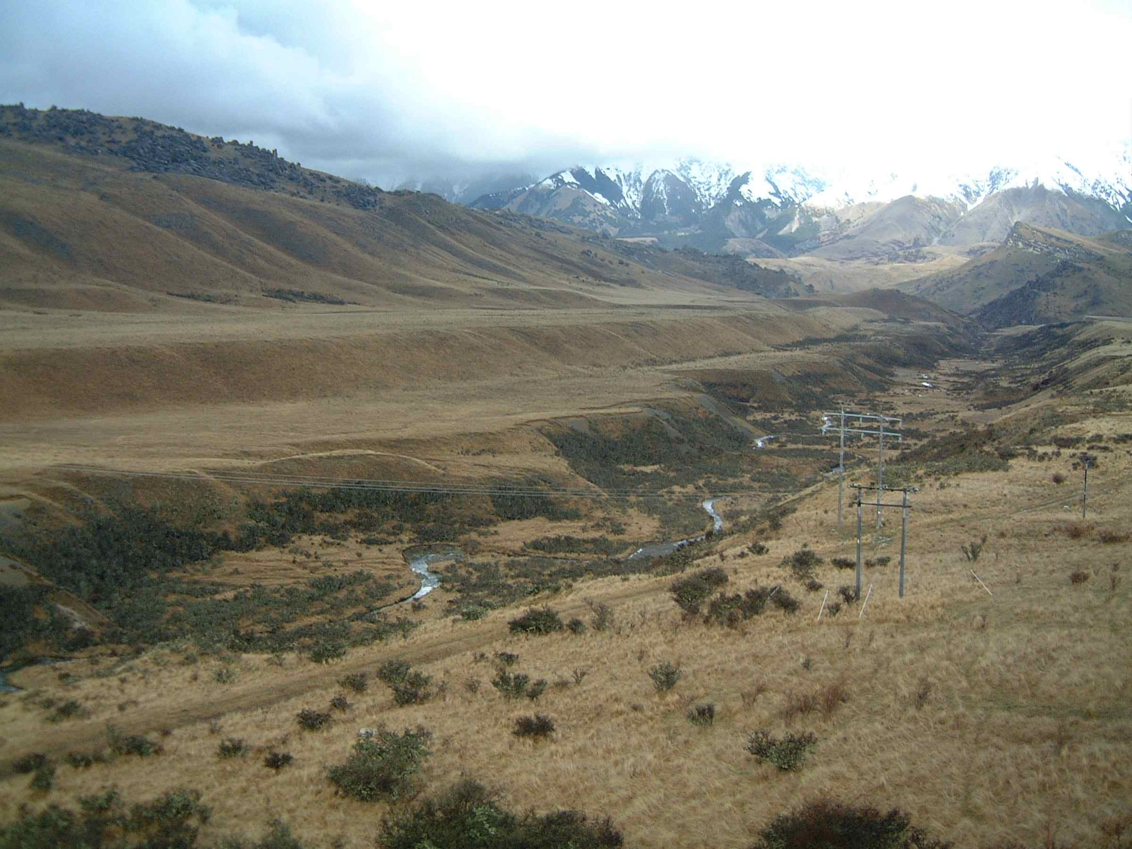
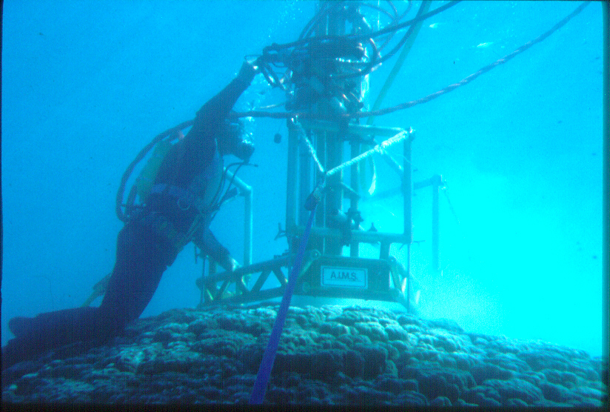
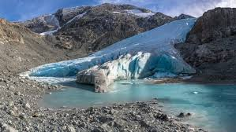
Palaeoclimatology
From Ruddiman (2008) Earth’s
Climate: past and future
From Australian Institute of Marine Science

Slide 5
Field work themes
Exploring the variety of field evidence for past climate changes preserved in glacial, fluvial, coastal and karst environments, and how we can work out when these changes occurred
The different temporal and spatial scales of Quaternary climate changes and the mechanisms responsible
The interplay between climate and other processes (e.g. tectonic uplift, landscape evolution)
The response of NZ glaciers to recent climate changes

Slide 6
Subject structure
Pre-field trip:
  Lectures (Mon 3 – Tue 4 Feb 2025)
  Assignment 1 (due Fri 7 Feb 2025)
Field trip – NZ (Mon 10 Feb – Sat 22 Feb 2025)
  Group booking with Air NZ (visas are your responsibility)
  Arrive Christchurch by ~2:30 p.m. Mon 10 Feb 2025
  We return to Christchurch ~6 p.m. Fri 21 Feb 2025
  Depart Christchurch ~6 a.m. Sat 22 Feb 2025
Post-trip classes: Mon 3 Mar and Tue 4 Mar 2025 (lectures / labs)
Field report due Fri 28 Mar 2025

Slide 8
Field work logistics
Getting around: Minibuses / 4WD
Accommodation: hostel style/bunk rooms
Meals: mostly self-catering - we buy the food, you guys cook! (3 meals not included)
Physical requirements: a moderate level of fitness
Academics support: Russell Drysdale, Agathe Lise-Pronovost and Calla Gould-Whaley

Slide 9
Entry into the subject
Places: Limited to 20 (mixture of Masters and undergraduate; entry based on WAM and academic background)
  14 October 2024: submit EOI form (web link)
  21 October 2024: students notified of a place and reserve list created
  28 October 2024: $200 deposit due
  11 November 2024: enrolments open
  25 November 2024: final payment due (t.b.a.) and final date of self-enrolment
Second info session: 4-5 pm 2 December 2024 Theatre 1 or 2 in Geography building (subject outline and final field program)
Field trip costs: Assume ~$2000-$2400 (includes flights)
Optional heli flight: Fox Glacier ~$500

Slide 10
What you need to bring
Essential
Sleeping bag and pillow case
Tent if you have one
Good quality wet weather gear
Cool weather gear
Sturdy field boots
Gear to eat with: plate, bowl, eating irons...
Field items: notebook, pens/pencils, ruler, calculator, weather protection for notebook
Spare torch
Spare small clean backpack and clean clothes for caving
Loo paper
Highly desirable
Laptop
Camera
Music (subject to approval by the drivers!)
NB: bringing fresh food into NZ is generally prohibited, so most of what you will eat will need to be purchased there. All gear you bring will need to be clean, otherwise it will be nuked when you clear customs

